Slide 1
WELCOME

Slide 2
Alka Hopital Pvt.Ltd
Alka Institute of Medical sciences(AIMS)
Hattiban, Lalitpur
Presentation on :- Community Field Survey
Prepared by: PBBN 2nd year students

Slide 3
Objectives
Provide comprehensive health care to individuals and families by utilizing the local available resources.
Identify health problems and needs and plan, implement and evaluation of individual, families and communities.
Collection of data for family folder, health action then analyze the data to prepare report for presentation.

Slide 4
Empower the community participation including resources for the community development.
Coordinate with the clinic and nearest health institution for maternal health, child health and family planning services.
Plan and participate in school health program in order to raise the health status of community people.
Make a referral to the appropriate agencies if needed.

Slide 5
Population Description
Total Population (N) 923
Index
Female
Male

Slide 6
Description of education

Slide 8
DATA ANALYSIS ON HEALTH SEEKING BEHAVIOUR
Health Seeking behavior | Total No. of Families
Hospital | 178
Traditional healers | 5
Both hospital and traditional healers | 7
N=923
Total Family = 190

Slide 10
Bar diagram showing water purification methods

Slide 11
Methods of Waste Disposal
1.Municipality :137
2.Dumping : 3
3.Burning and Composting : 8
4.Municipality and Composting : 23
5.Burning and Dumping : 3
6.Composting , Dumping and Composting : 3
7.Composting , Burning and Municipality : 5
8.Composting and Dumping : 6
9.Municipality and Burning : 2
Index
N=923
Total Family = 190

Slide 12
N=923

Slide 13
N = 923

Slide 14
N = 923

Slide 15
Description of Acute illness
Name of illness | No of male sufferer | No of female sufferer
Common cold | 1 | -
Jaundice | - | 1
Nephrolithiasis | - | 1
Hyperemesis Graviderum | - | 1

Slide 16
Description of Chronic illness

Slide 17
Death within one year in the family
Full form:
CKD: Chronic Kidney disease.
CLD: Chronic liver disease.
COPD: Chronic Destructive Pulmonary Disease

Slide 18
Family Planning description
N=923
Total couples=173

Slide 19
Description of ANC & PNC
 | Total
ANC | 22
PNC | 5
INDEX
N=923
n=27

Slide 20
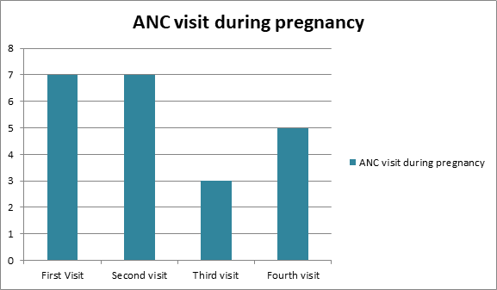
N=923
n=22

Slide 21
DATA ANALYSIS ON WEANING
Weaning done at | No of children
Below 6 months | 38
6 months | 30
Above 6 months | -
Not done yet | 3
Total | 69

Slide 22
Under five children immunization
Age in months | Male | Female
0-1Years (birth- 12months) | 9 | 12
1-3years (13months-36months) | 21 | 14
3-5years (37months-59months) | 11 | 4
Total | 41 | 30

Slide 24
THANK YOU

